Slide 1

Enums
Prepared by Tatsiana Hurskaya
Kiryl Bulakh
Notes:
Just into on why we’re here today and what’s the point of having this presentation. Brifely touch the topic of presenters: SZ, OZ, IL, and KK.
In the end: passing the floot to Sviatlana.

Slide 2
Plan
What is enum and how to create it
Properties and methods
Where we can use enums
QA

Slide 3
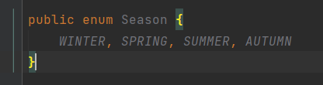

Enum is
a special "class" that represents a group of constants
added to the Java language in JDK 1.5
Enum constants are implicitly static and final and you can not change their value once created.
Enum may implement many interfaces, but cannot extend any class because it internally extends Enum class

Slide 4
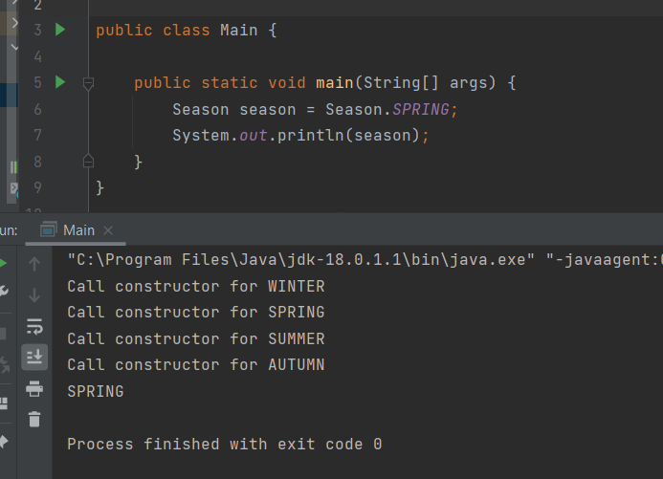
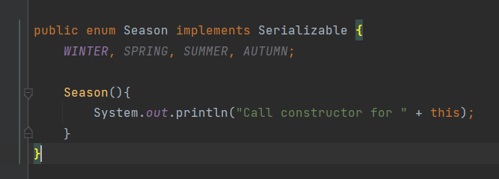
Enum’s constructor
Enum can contain a constructor and it is executed separately for each enum constant at the time of enum class loading.
We can’t create enum objects explicitly and hence we can’t invoke enum constructor directly.

Slide 5
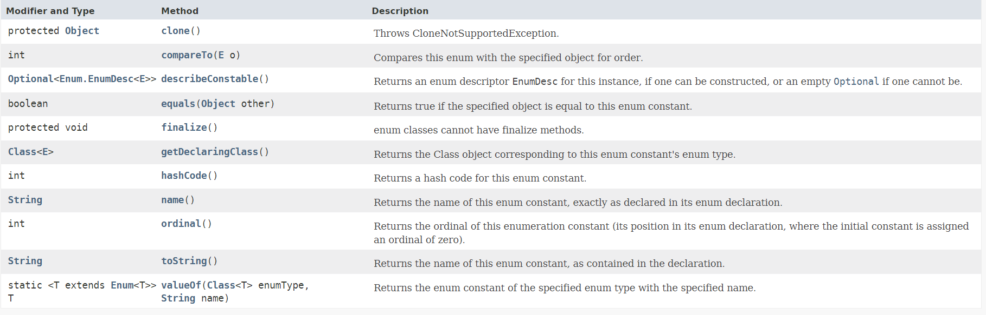
Enum methods

Slide 6
Enum improves type safety
A language is type-safe if the only operations that can be performed on data in the language are those sanctioned by the type of the data
Enum is type-safe you can not assign anything else other than predefined Enum constants to an Enum variable.

Slide 7
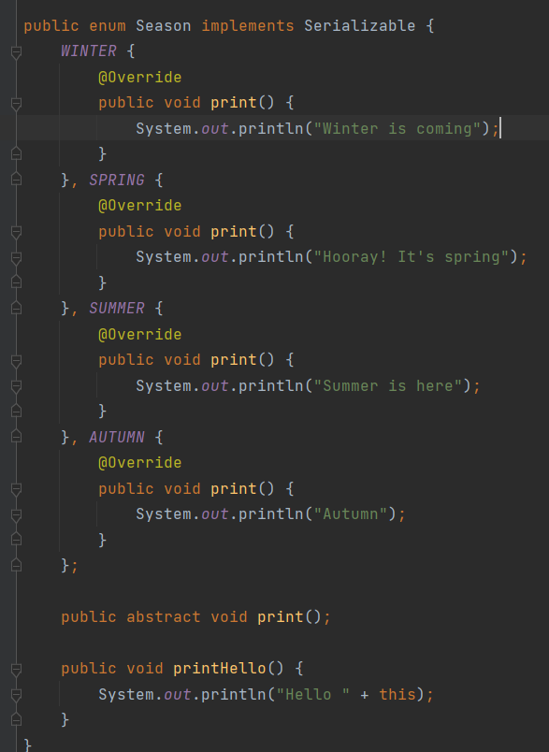
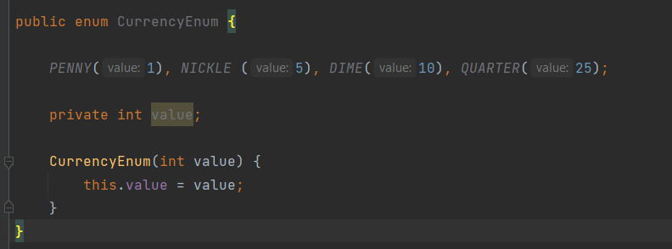
Enums can have fields and methods

Slide 8
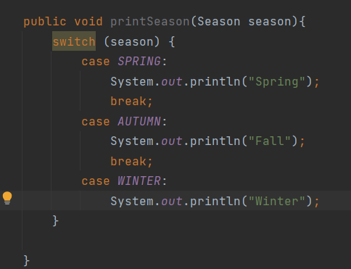
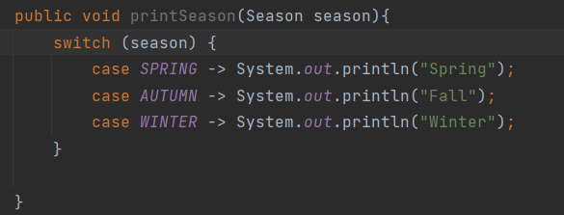
Use cases: Switch

Slide 9
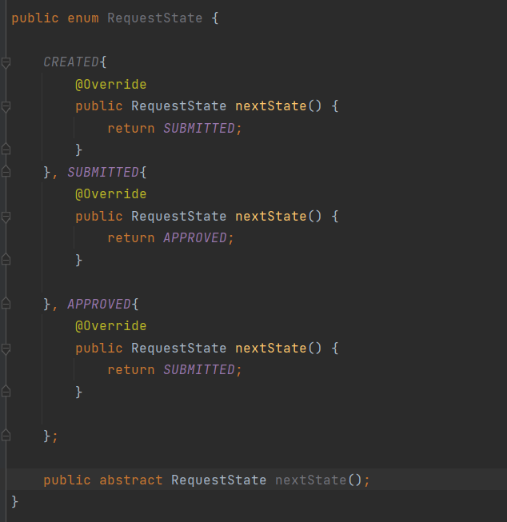
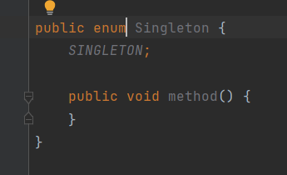
Use cases: Implementing design patterns (Strategy, State, Singleton)

Slide 10
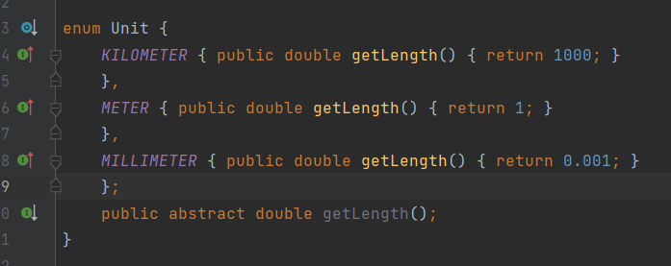
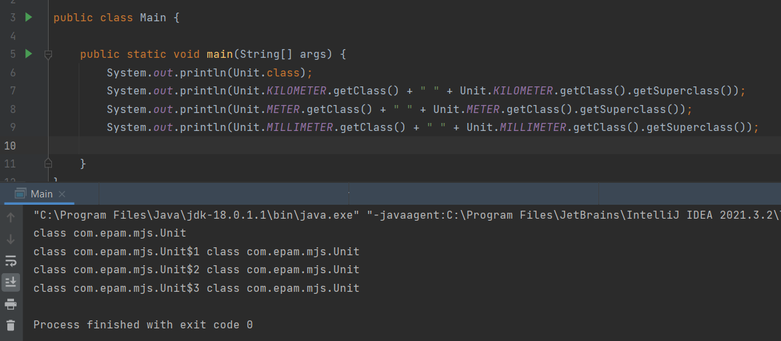
Inheritance in enum
Using enum in Java, it is possible to implement a class hierarchy, the objects of which are created in a single instance and are available statically. However, enum elements can contain their own constructors.
Unit - class inheriting from java.lang.Enum
KILOMETER - object of the 1st class inherited from Unit
METER - object of the 2nd class inherited from Unit
MILLIMETER - object of the 3rd class inherited from Unit

Slide 11
QA
Do you have any questions?

